Slide 1
ADVANCED ENGINEERING PHYSICS
UNIT-IV
Quantum Mechanics
Syllabus
Introduction, de-Broglie hypothesis, Heisenberg uncertainty principle, physical significance of wave function, postulates of quantum mechanics: operators in quantum mechanics, eigen values and eigen functions, expectation value; Schrödinger’s time independent wave equation, particle in a 1D box, Bloch’s theorem (qualitative), Kronig -Penney model (qualitative): E-k diagram, effective mass of electron, formation of energy bands, origin of bandgap, classification of solids, concept of discrete energy levels and quantum confinement in nanomaterials.

Slide 2
Quantum Mechanics is a fundamental branch of physics that describes the behavior of matter and energy at very small scales, such as atoms, subatomic particles, and photons.
de-Broglie Hypothesis
In 1924, Louis de Broglie proposed that matter, just like light, exhibits both particle and wave nature. This idea extended the concept of wave – particle duality from photons to all material particles. ​
According to de Broglie, every moving particle of mass m and velocity v is associated with a wavelength, called the de Broglie wavelength.
As per Einstein, E = mc²; & As per Max Plank, E = h𝜐;
mc² = h𝜐 ⟶ mc² = hc/​λ
λ = h/mc = h/p
If ‘E’ is the KE of the electron, λ = h/√2mE;
If V - accelerate voltage to the electron, λ = h/√2meV = 12.24/√ V Å.
Where, λ = de Broglie wavelength, h- Planck’s constant, P- momentum, e -charge of the electron, m – mass of the electron.

Slide 3
Heisenberg Uncertainty Principle
Heisenberg Uncertainty Principle states that it is impossible to simultaneously measure the exact position and exact momentum of a particle with infinite precision.
Δx Δp ≥ h/4π​
Where, Δx = uncertainty in position, and Δp = uncertainty in momentum
Physical Meaning
If we try to localize a particle precisely (Δx→0), its momentum becomes highly uncertain (Δp→∞). Conversely, if momentum is known exactly, the particle’s position becomes completely uncertain.
The principle applies to other pairs of conjugate variables, such as:
ΔE⋅Δt ≥ h/4π, ​ and ΔJ⋅Δ𝛉 ≥ h/4π
Where, Δ𝛉 = uncertainty in angular position, ΔJ = uncertainty in angular momentum, ΔE = uncertainty in Energy, and Δt = uncertainty in time

Slide 4
Wave Function (ψ):
In quantum mechanics, the wave function ψ(x,t) is a complex-valued function that contains all possible information about the state of a quantum particle (such as an electron, photon, atom, etc.).
Physical Significance:
The wave function itself has no direct physical meaning, since it is generally complex.
The square modulus of the wave function gives the probability density
P(x,t) = ∣ψ(x,t)∣²
Where, P(x,t) dx is a probability of finding the particle between x and x+dx at time t. For a 3D system: P(r⃗,t)=∣ψ(r⃗,t)∣² gives the probability density in space.
3. The existence of the particle, the wave function must satisfy the normalization condition, meaning the total probability of finding the particle in all space equals one. ∫_{−∞}^{+∞} ∣ψ(x,t)∣² dx = 1

Slide 5
Postulates of Quantum Mechanics
Postulate 1: State of a system
The complete state of a quantum system is described by a wave function ψ(x,t). This function contains all the measurable information about the system. The probability of finding the particle between xx and x+dx is given by: P(x)dx = ∣ψ(x,t)∣² dx
The wave function must be normalized: ∫ ^{+∞} _{−∞} ∣ψ(x,t)∣² dx = 1
Postulate 2: Observables and Operators
Every measurable physical quantity (observable) is represented by a linear Hermitian operator. Examples: Position operator: x^ = x; Momentum operator: p^=−iℏ∂/∂x; and Energy (Hamiltonian): H^ = −ℏ² /2m∇² + V(x).
Postulate 3: Measurement and Eigenvalues
Measurement of an observable always gives one of the eigenvalues of the corresponding operator. If: A^ψ = aψ then a is an eigenvalue, and ψ is the corresponding eigenfunction. Example: For a free particle, the momentum operator acting on a plane wave ψ = e^{ikx} gives:
p^ψ = − iℏ∂/∂x(e^{ikx}) = ℏkψ
Here, ℏk is the eigenvalue (momentum)

Slide 6
Postulate 4: Expectation Value
The expectation value (average value in repeated measurements) of an observable A is:
⟨A⟩ = ∫_{−∞} ^{+∞} ψ∗(x, t) A^ ψ(x, t) dx
This connects the mathematics (operators) with physical reality (measured values).
Postulate 5: Time Evolution
The time evolution of the system is governed by the time-dependent Schrödinger equation:
iℏ∂/∂tψ(x,t) = H^ ψ(x, t)
The Hamiltonian operator H^ determines how the wave function evolves with time.
Schrödinger time independent wave equation
Schrödinger wave equation is a basic wave equation of a fundamental quantum mechanics. Consider a particle of mass (m) , moving with velocity (v) and wavelength (λ).
According to de Broglie

Slide 7
If E is the total energy of the system
Periodic changes in Ψ are responsible for wave nature
of a moving particle
The displacement of de Broglie wave associated with a moving particle along x-direction is given by
In three dimensions, it is given by
Where, A – amplitude, x - position co-ordinate, and λ – wavelength

Slide 8
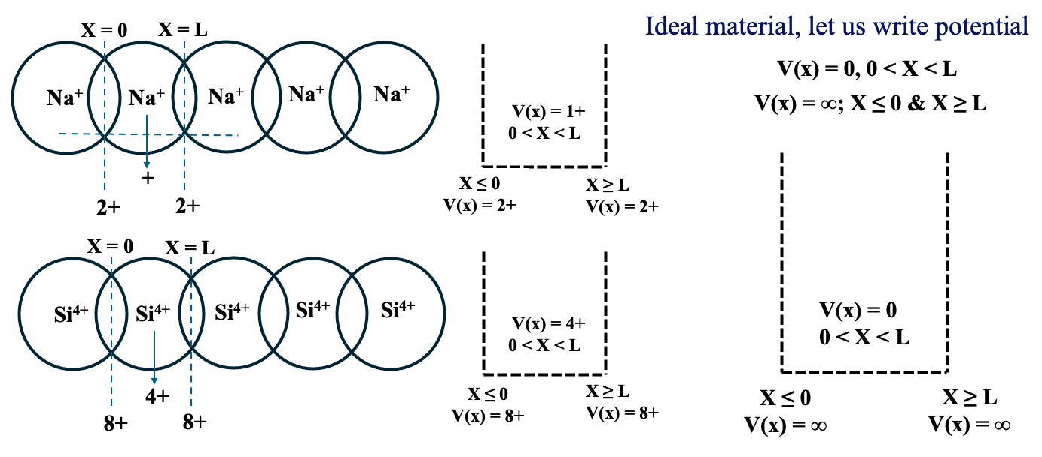
Particle in a one-dimensional potential well (or) box
Consider an electron of mass ‘m’ in an infinitely deep one-dimensional potential box with a width of a ‘L’ units in which potential is zero.

Slide 9
The motion of the electron in one dimensional box can be described by the Schrödinger's equation.
At, X = 0, V(x) = ∞, the electron wave function Ψ(x) = 0 -- (1)
X = L, V(x) = ∞, the electron wave function Ψ(x) = 0 -- (2)
Applying 1st boundary conditions to solution
0 = A Sin k(0) + B Cos k(0)
B = 0
Substitute B value solution, Ψ(x) = A Sin kx
Applying second boundary condition
0 = A Sin k(L) + (0) Cos k(L)
0 = A Sin k(L)
0 = Sin k(L)
kL = n𝜋
k = n𝜋/L
Substitute B and k value in solution
Inside the box the potential V =0
The solution to above equation can be written as
Where, A, B and K are unknown constants and to calculate them, it is necessary to apply boundary conditions.

Slide 10
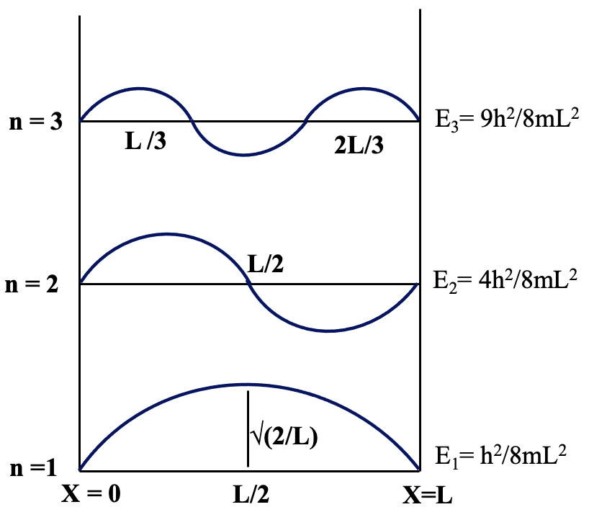
To calculate unknown constant A, consider normalization condition
The normalized wave function is
The wave function Ψ_{n} and corresponding energies E_{n} are called called Eigen functions and Eigen value of the quantum particle.
Normalized wave function in three dimensions is given by

Slide 11
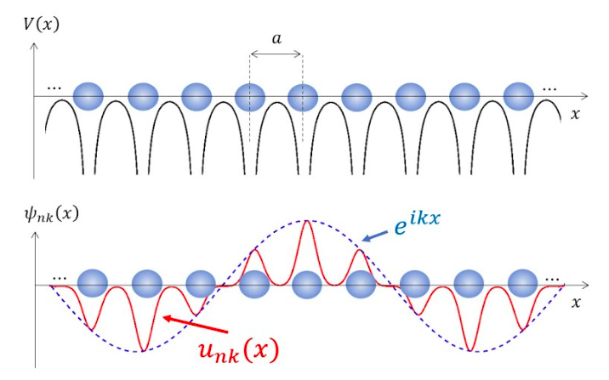
Bloch theorem - Electron in a periodic potential
Bloch’s theorem provides the mathematical foundation for understanding how electrons move in crystals, leading to the band theory of solids and explaining conductivity, semi-conductivity, and insulating behavior.
In a crystalline solid, the atoms are arranged in a periodic lattice. This periodic arrangement creates a periodic potential V(x) experienced by the electrons. Mathematically, the potential satisfies V(x+a)=V(x) for all lattice translation vectors a.
Statement of Bloch’s Theorem
Bloch’s theorem states that the wave function of an electron in a periodic potential can be written as
ψ_{nk}(x) = u_{nk}(x) e^{ikx}
Where, k = crystal momentum (wave vector), n = band index,
u_{nk}(x) = function with the same periodicity as the lattice:
u_{nk}(x + a) = u_{nk}(x)

Slide 12
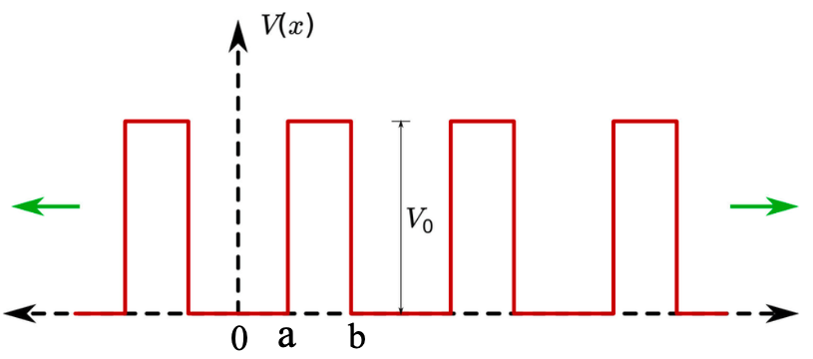
Kroning – Penney model (qualitative) : E-K diagram
The Kroning – Penney model is a one-dimensional quantum mechanical model that explains energy bands in solids by analysing electron behavior within a periodic potential, representing the lattice structure of a crystal.
In a crystal, atoms are arranged periodically, so electrons experience a periodic potential. The Kronig – Penney model represents this periodic potential as a series of rectangular potential wells/barriers. By solving the Schrödinger equation for this potential, one finds that only certain ranges of energies are allowed (energy bands), while other ranges are forbidden (band gaps).
For One-dimensional periodic potential:
V(x) = 0 0 < x< a ;
V(x) = V₀​ a < x < b​
Where,
a = width of the potential well,
b = width of the barrier,
V₀ ​- barrier height.

Slide 13
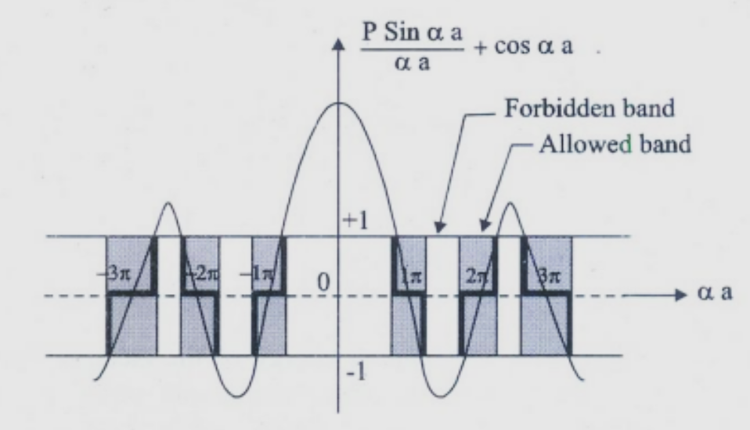

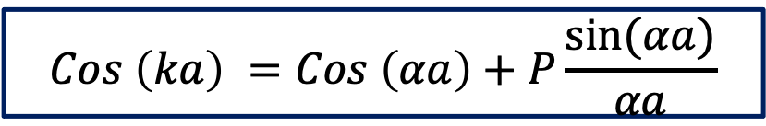
Applying Bloch theorem and solving Schrodinger wave equations, for these regions give us following final solution
$$Cos \left(ka\right) =Cos \left(αa\right)+P\frac{sin⁡(αa)}{αa}$$
w$here,P=\frac{mV_{0}ba⁡}{ℏ^{2}}$ ; $α=\frac{2mE⁡}{ℏ^{2}}$
P – Scattering Power of Potential Barrier; V₀b – Barrier Strength

Slide 14
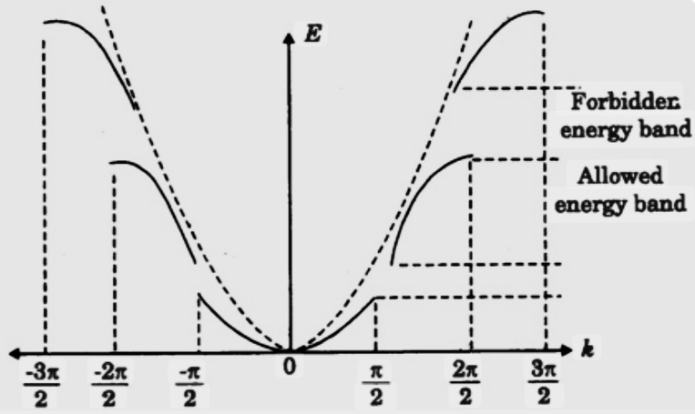
E-k diagram :
An E-k diagram from the Kroning- penny model is a plot of electron energy (E) versus wave vector (k) in a crystalline solid, illustrating how the energy levels of electrons are modified by the periodic potential of the crystal lattice.
The diagram shows energy bands (continuous allowed regions of energy) separated by forbidden energy gaps.
The periodic potential causes the otherwise parabolic relationship between energy and wave vector for a free electron to develop discontinuities, forming these bands and gaps that determine the electrical properties of materials like semiconductors.

Slide 15
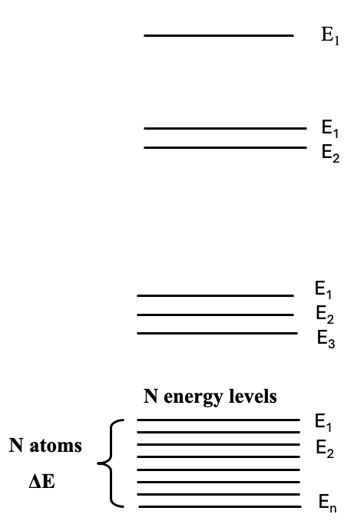
Origin of energy band formation in solids
The origin of energy band formation in solids arises from the quantum mechanical interaction of atoms when they come together to form a solid.
In a free atom, electrons occupy discrete energy levels (1s, 2s, 2p, etc.). Each electron level is sharply defined due to the absence of neighbouring atoms.
When many atoms come close to form a solid (say N atoms), their outermost (valence) orbitals start to overlap.
According to the Pauli Exclusion Principle, no two electrons can occupy the same quantum state. Therefore, the discrete atomic energy levels split into many closely spaced levels.

Slide 16
Formation of Energy Bands:
For a large number of atoms (N∼10²³ in a solid), the splitting produces quasi-continuous ranges of energy levels, called bands. Two important bands emerge:
  Valence Band → originates from the outermost electron orbitals.
  Conduction Band → higher unoccupied states just above the valence band.
The separation between them is the band gap (E_{g}).
Band Gap and Material Classification:
Depending on the magnitude of the band gap, the materials classified as following.
Conductors: Overlapping valence and conduction bands (E_{g} ≈ 0).
Semiconductors: Small bandgap (E_{g} ∼ 0.1–3eV).
Insulators: Large bandgap (E_{g} > 3eV).

Slide 17
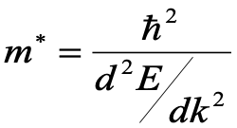
Effective mass of an electron:
The effective mass of the electron is a fundamental concept in solid-state physics that describes how an electron behaves inside a crystalline solid. In free space, electrons respond to external forces according to Newton’s law with their actual mass m₀​. However, inside a crystal, electrons move in the presence of a periodic potential created by the positively charged ion cores. This interaction alters the electron’s dynamics, and instead of behaving like a free particle, it acts as if it has a different mass, called the effective mass m∗.
Mathematically, the effective mass is related to the curvature of the electronic energy band E(k) as a function of the crystal momentum (wave vector k):
Where, ℏ is the reduced Planck’s constant, E(k) is the energy as a function of wave vector k.

Slide 18
Concept of discrete energy levels:
In isolated atoms or molecules, electrons occupy well-defined discrete energy levels. However, when a large number of atoms come together to form a solid, these discrete levels overlap due to the close interaction of atomic orbitals. As a result, the individual atomic levels broaden into continuous energy bands, giving rise to the valence band and conduction band separated by a bandgap in bulk materials. Thus, while atoms show discrete levels, bulk solids exhibit continuous energy bands.
Quantum confinement in nanomaterials:
When the size of a material is reduced to the nano-meter scale, comparable to the exciton Bohr radius, the situation changes drastically. At this scale, electrons and holes experience spatial confinement, and their motion becomes restricted in one or more dimensions. This phenomenon is called quantum confinement.
Due to this confinement, the continuous bands of the bulk material break up into discrete energy states again, resembling the behavior of isolated atoms. This is why quantum dots are often referred to as "artificial atoms.

